Slide 1

Xamarin ♥ .NET Core
Marco Minerva
Microsoft MVP
https://about.me/marcominerva

Slide 2










Your platform for building anything
DESKTOP
WEB
CLOUD
MOBILE
GAMING
IoT
AI
.NET
Notes:
You can build anything with .NET.
We’ve made significant investments in .NET over the years as well as unifying the ecosystem to support building literally anything. From desktop to gaming to the cloud, .NET is a general purpose programming platform that enables all kinds of application scenarios. Once you learn one, you can easily pick up another.

Slide 3
.NET Core 3 runs everywhere
We can use its built-in features on every platform
Dependency Injection
Inversion of Control
Configuration
Logging
HttpClientFactory support
...
HostBuilder is the key

Slide 4
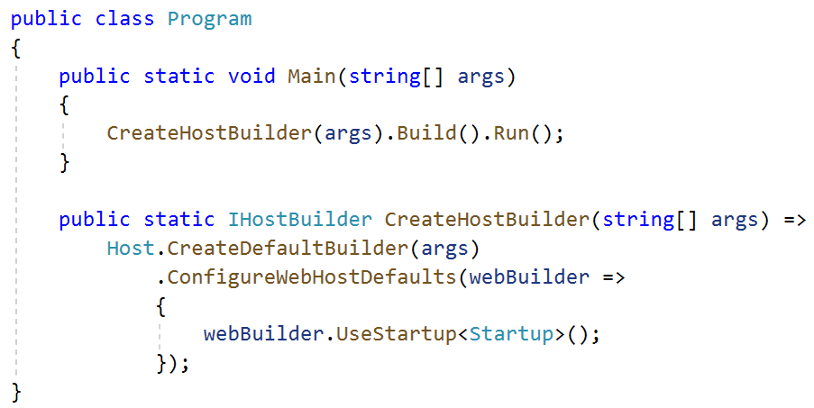
HostBuilder with ASP.NET Core
Till .NET Core 2.2, HostBuilder was available only for ASP.NET Core worload
Now we can use it on every platform

Slide 5
Demo
HostBuilder with Xamarin.Forms

Slide 6

HttpClientFactory
HttpClient often isn’t properly used
When disposed, the underlying socket is not immediately released
If used as singleton, it fails to handle DNS changes
HttpClientFactory allows to create HttpClient instances
It handles lifetimes, caching, logging, …
Can be combined with Polly for resilience and and transient-fault-handling

Slide 7
Demo
HttpClientFactory with Xamarin.Forms

Slide 8
Resources
https://github.com/marcominerva/XamarinNetCore
https://docs.microsoft.com/en-us/aspnet/core/fundamentals/host/generic-host
https://docs.microsoft.com/en-us/aspnet/core/fundamentals/dependency-injection
https://docs.microsoft.com/en-us/aspnet/core/fundamentals/logging
https://docs.microsoft.com/en-us/aspnet/core/fundamentals/http-requests
https://github.com/App-vNext/Polly

Slide 9

Thank you
Marco Minerva - @marcominerva
Microsoft MVP – Windows Development
https://about.me/marcominerva
© 2020 Microsoft Corporation. All rights reserved.

